Slide 1
2018 Global Day of Azure Developer Track

Slide 2
Presented by
Calgary .Net User Group
Simon Timms (President)
David Paquette (Past President)
Sean Feldman (Knower of many things Azure)
Blake McNeill (Token Old Guy)
Website: https://www.meetup.com/Calgary-net-User-Group
Twitter: @DotNetCalgary

Slide 3
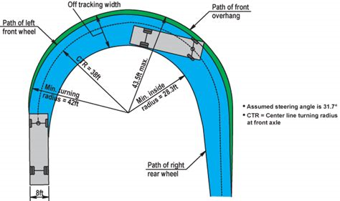
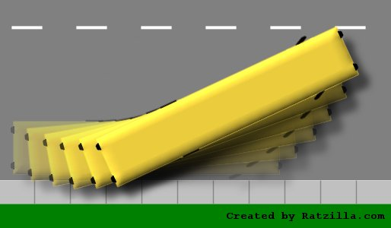
School Bus Off Track and Tail Swing

Slide 4

Captain Obvious Moment
Notes:
Azure is a freaking giant huge freaking beast and growing quickly, we will only be covering a very small portion of Azure in this lab.
Also this is a sample app designed to show some of the features of Azure not a product we would put into production.

Slide 5
What we are building
A device that measures temperature and sends a reading up to Azure every 15 seconds.
If the temperature exceeds 21 C Azure will send a message to the device turning on the LED
If the temperature falls back below 21 C Azure will send a message to the device to turn off the LED
IoT Device
IoTHub
Event Grid
Stream Analytics
Event Hub
Cloud Service
Azure Function (Serverless App)
PowerBI
CosmosDB
ML (Anomaly Detection)

Slide 6
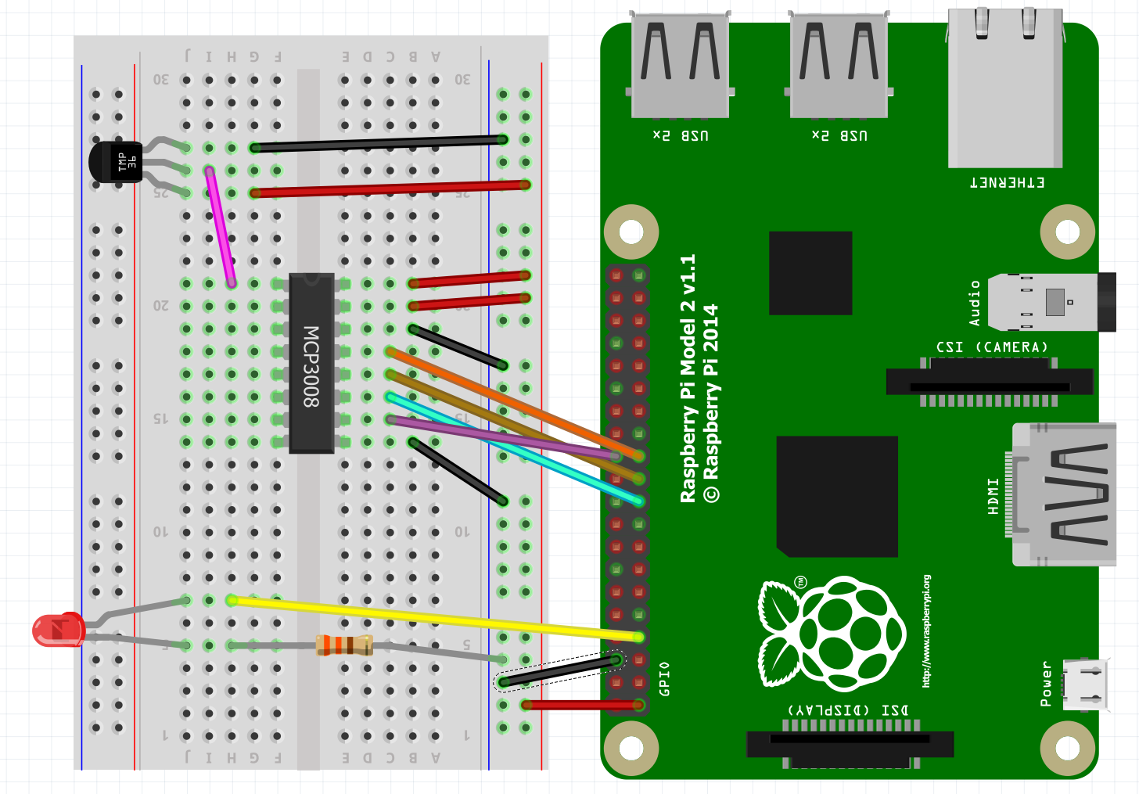
What we are building (a simulated one)

Slide 7
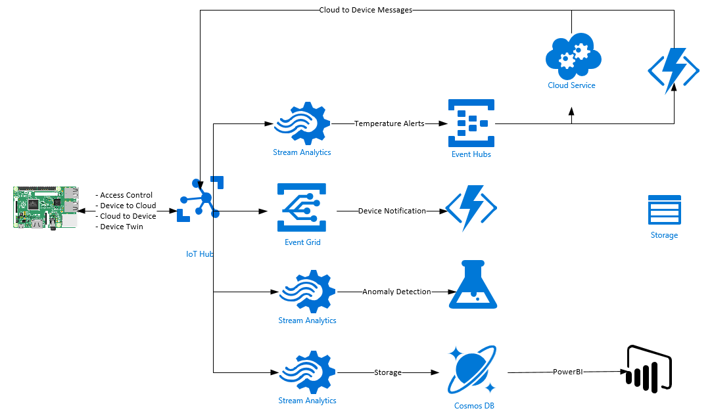
What we are building

Slide 8
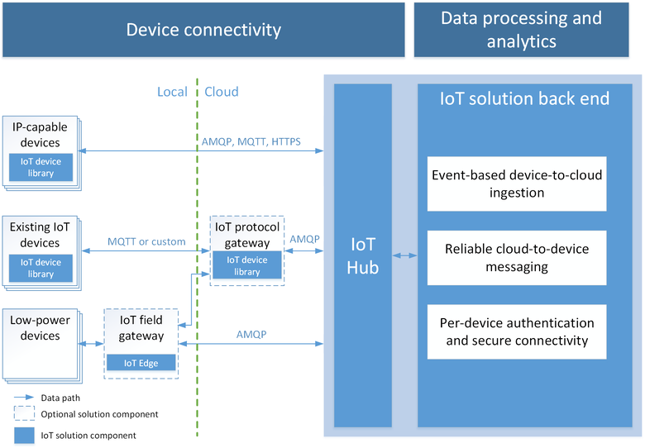
Azure IoT Hub
Notes:
fully managed service that enables reliable and secure bidirectional communications between millions of IoT devices and a solution back end. Azure IoT Hub:
Provides multiple device-to-cloud and cloud-to-device communication options. These options include
one-way messaging,
file transfer, and
request-reply methods.
- Provides built-in declarative message routing to other Azure services.
- Provides a queryable store for device metadata and synchronized state information.
- Enables secure communications and access control using per-device security keys or X.509 certificates.
- Provides extensive monitoring for device connectivity and device identity management events.
- Includes device libraries for the most popular languages and platforms.

Slide 9
Azure IoT Hub
Per-device authentication and secure connectivity
Can provision each device with its own security key to enable it to connect to IoT Hub. The
IoT Hub identity registry stores device identities and keys in a solution.
Back end can add individual devices to allow or deny lists to enable complete control over device access.
Route device-to-cloud messages to Azure services based on declarative rules.
IoT Hub enables you to define message routes based on routing rules to control where your hub sends device-to-cloud messages.
Integrate IoT Hub events into your business applications.
Integrates with Azure Event Grid. Use this integration to configure other Azure services or third-party applications to listen for IoT Hub events.
Monitoring of device connectivity operations. You can receive
Detailed operation logs about device identity management operations and device connectivity events.

Slide 10
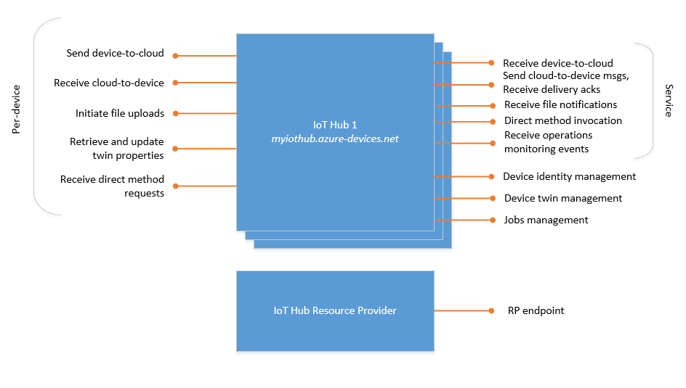
Azure IoT Hub

Slide 11
Azure IoT Hub
An extensive set of device libraries.
Azure IoT device SDKs are available and supported for various languages and platforms
IoT protocols and extensibility.
Creating a field gateway with Azure IoT Edge that converts your custom protocol to a protocol understood by IoT Hub.
Customizing the Azure IoT protocol gateway, an open-source component that runs in the cloud.
Scale.
Millions of simultaneously connected devices and millions of events per second.
Device provisioning. The
IoT Hub Device Provisioning Service is a helper service for IoT Hub that enables zero-touch, just-in-time device provisioning to the right IoT hub without requiring human intervention
Device twins
Store, synchronize, and query device metadata and state information.
IoT Hub maintains a device twin for each device that you connect to IoT Hub.

Slide 12
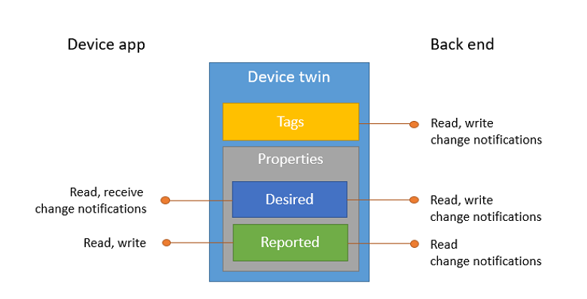
Azure IoT Hub - Twinning
Device twins are JSON documents that store device state information including metadata, configurations, and conditions. Azure IoT Hub maintains a device twin for each device that you connect to IoT Hub.
Notes:
A device twin is a JSON document that includes:
Tags. A section of the JSON document that the solution back end can read from and write to. Tags are not visible to device apps.
Desired properties. Used along with reported properties to synchronize device configuration or conditions. The solution back end can set desired properties, and the device app can read them. The device app can also receive notifications of changes in the desired properties.
Reported properties. Used along with desired properties to synchronize device configuration or conditions. The device app can set reported properties, and the solution back end can read and query them.
Device identity properties. The root of the device twin JSON document contains the read-only properties from the corresponding device identity stored in the identity registry.

Slide 13
Device To Cloud
Device-to-cloud messages are durable and retained in an IoT hub's default messages/events endpoint for up to seven days.
Device-to-cloud messages can be at most 256 KB, and can be grouped in batches to optimize sends. Batches can be at most 256 KB.
As explained in the Control access to IoT Hub section, IoT Hub enables per-device authentication and access control.
IoT Hub allows you to create up to 10 custom endpoints. Messages are delivered to the endpoints based on routes configured on your IoT hub. For more information, see Routing rules.
IoT Hub enables millions of simultaneously connected devices (see Quotas and throttling).
We are going to use the Free Hub
higher of 100/sec or 12/sec/unit D2C Sends or Connections
1.67/sec/unit C2D Sends
IoT Hub does not allow arbitrary partitioning. Device-to-cloud messages are partitioned based on their originating deviceId.

Slide 14
Cloud To Device
To guarantee at-least-once message delivery
IoT Hub persists cloud-to-device messages in per-device queues
Devices must explicitly acknowledge completion for IoT Hub to remove them from the queue
If you fail to notify IoT Hub, messages automatically transition from the Invisible state back to the Enqueued state after a visibility (or lock) timeout. The default value of this timeout is one minute.
A device can also choose to
Reject the message
IoT Hub sets it to the Dead lettered state.
Devices that connect over the MQTT protocol cannot reject cloud-to-device messages.
Abandon the message
causes IoT Hub to put the message back in the queue, with the state set to Enqueued.
Devices that connect over the MQTT protocol cannot abandon cloud-to-device messages.

Slide 15
Cloud To Device
The max delivery count property on IoT Hub determines the maximum number of times a message can transition between the Enqueued and Invisible states (ie how many times it tried to send it).
After that number of transitions, IoT Hub sets the state of the message to Dead lettered.
Similarly, IoT Hub sets the state of a message to Dead lettered after its expiration time (see Time to live).
Every cloud-to-device message has an expiration time.
The ExpiryTimeUtc property in the service.
IoT Hub using the default time to live specified as an IoT Hub property.

Slide 16
Cloud To Device
One Way Notification
All messages show up at the same place in your app
No response sent back
Messages can be retained by IoT Hub for up to 48 hours
Single Device only
Up to 64 KB messages
Low Frequency
Available on all protocols but must poll when using HTTP

Slide 17
Cloud To Device
Direct Method
Calls to a routine in your app
Two-way. The device app can respond to the method right away. The solution back end receives the outcome contextually to the request.
Disconnected devices are not contacted. The solution back end is notified that the device is not connected.
Single device or multiple devices using jobs.
Up to 8 KB requests and 8 KB responses.
High Frequency (depending on IoT Hub Limits)
Available using MQTT or AMQP only

Slide 18
Let’s Build Us Some Azure

